Slide 1
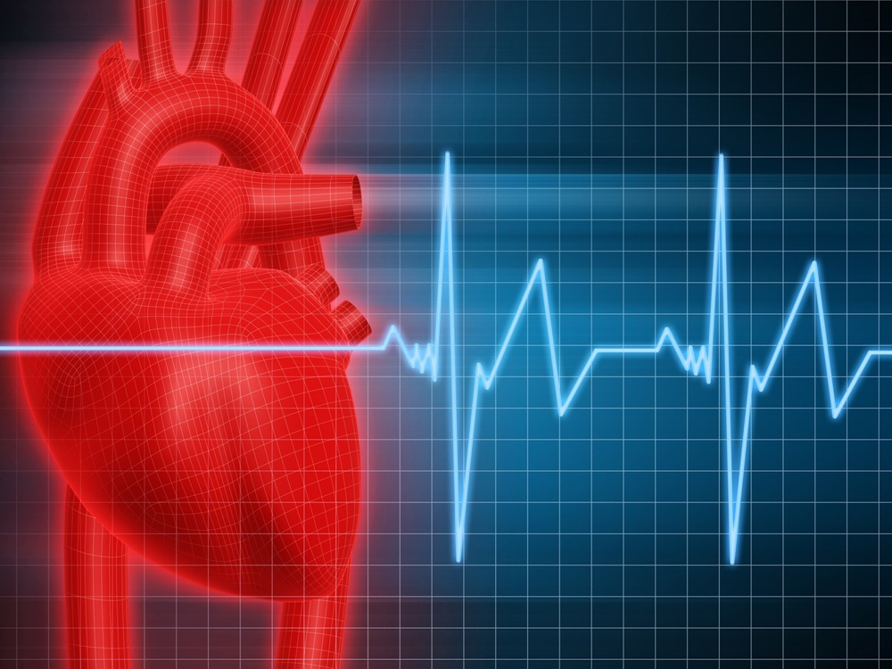
PTA/OTA 106 Unit 2 Lecture 1

Slide 2
Position of the heart and Associated Structures
Coronary trivia
Pumps blood through 60,000 miles of blood vessels
Pumps about 3,600 gal per day
2.6 million gal per year

Slide 3
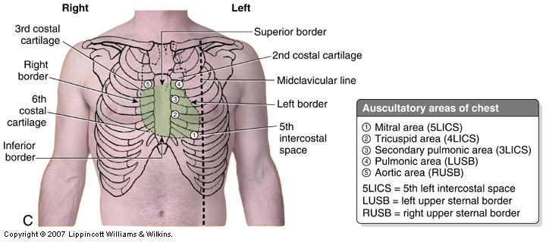
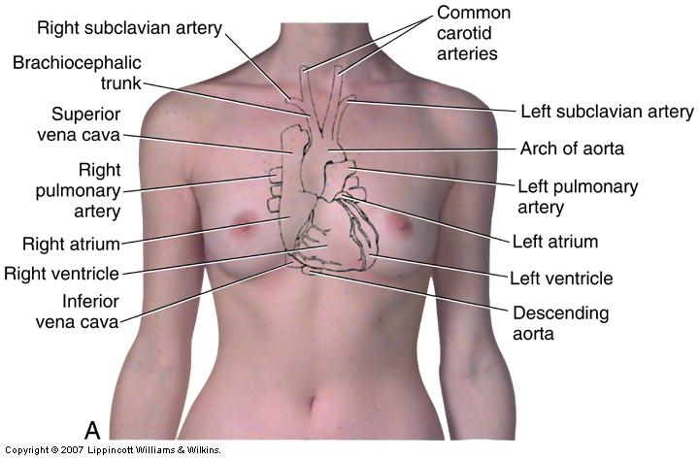
Approximate Location of the heart projected to the surface
Landmarks
Superior R point: Is at the superior border of the R 3rd costal cartilage
Superior L point: Is located at the inferior border of the L 2nd costal cartilage
Inferior L point: (the apex) is located at of the heart in the L 5th intercostal space
Inferior R point: Is located at the superior border of the sixth R costal catilage

Slide 4
Layers of the heart wall and it’s associated membranes

Slide 5
External Anatomy of the Heart

Slide 6
External Anatomy of the Heart

Slide 7
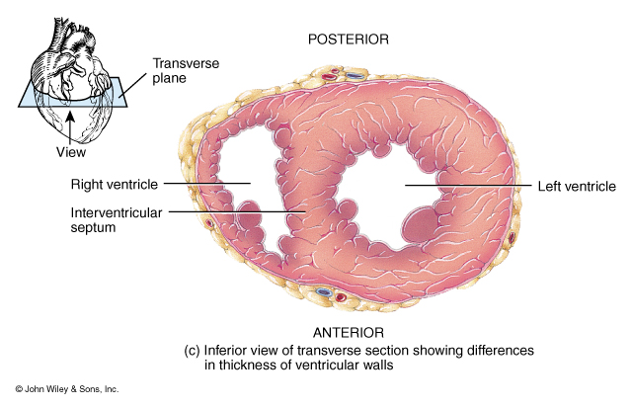
Internal Anatomy of the Heart

Slide 8
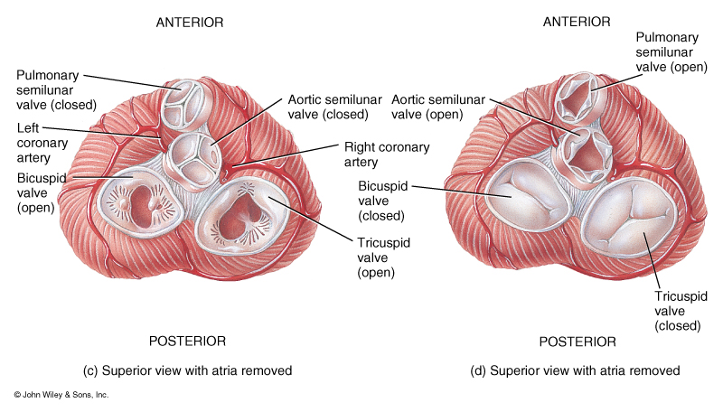
Position and Function of the Cardiac valves

Slide 9
Circulations Patterns of the Heart

Slide 10
Coronary Vessels and circulation

Slide 11
Cardiac Conduction Systems: the Heart pacemaker

Slide 12
Physiology of Cardiac Muscle Contraction
Action potential initiated by the SA node
Action potential conducted to the purkinje fibers
Depolarization of sarcolemma opens voltage-gated fast Na+ channels causing rapid depolarization
Prolonged depolarization called the “plateau” involves opening of voltage-gated slow Ca2+ channels

Slide 13
Physiology of Cardiac Muscle Contraction
Repolarization is caused by opening of voltage-gated K+ channels
The prolonged depolarization causes an absolute refractory period where the cardiac muscle can not respond to additional stimulus.

Slide 14
The parts of an Electrocardiogram (EKG) during a cardiac cycle
P wave =
atrial depolarization
(Large P = atrial enlargement)
QRS complex =
ventricular depolarization
(Large Q = myocardial infarction)
T Wave =
ventricular repolarization
(Flat T = coronary artery disease)
P-Q interval =
Time required for conduction from SA node to purkinje fibers

Slide 15
The parts of an Electrocardiogram (EKG) during a cardiac cycle
S-T segment =
Time when ventricular myocardia is depolarized
(elevated S-T indicates acute myocardial infraction}
Q-T interval=
time form start of ventricular depolarization to ventricular repolarization.
(Lengthened by myocardial damage)

Slide 16
The Cardiac Cycle:
Atrial Systole
Atrial Diastole
Ventricular fillling
Ventricular Ejection
Ventricular Systole
Ventricular Diastole
Isovolumetric Contraction
Isovolumetric Relaxation

Slide 17
The Cardiac Cycle:
End-diastolic volume
End-systolic volume

Slide 18
Cardiac Output (CO)
CO = volume of blood ejected from the left ventricle into the Aorta each minute.
CO = SV x HR
SV = stroke volume, volume of blood ejected from ventricle (70 ml)
HR = Heart rate, heartbeats per minute

Slide 19
Cardiac Output (CO)
Factors the effect SV
1. Preload: degree of stretch of the myocardium before contraction
2. Contractility: force of contraction of the ventricular myocardium
3. Afterload: Force or pressure that the ventricular myocardium must exceeded to open the semilunar valves.

Slide 20
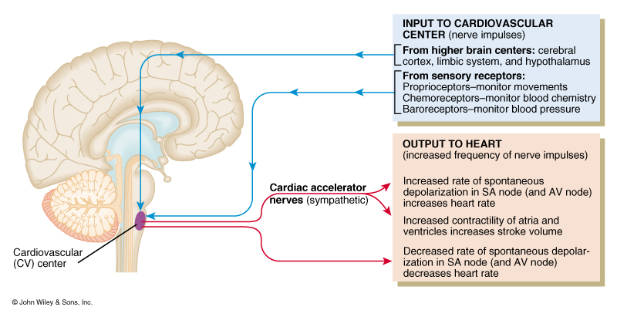
Nervous Control of Cardiac Activity

